Slide 1







PAPER 1
Guided textual analysis
Key information, processes and resources
Prepared by Ms.Ancila

Slide 2



INFORMATION
Paper 1 is an unseen, externally assessed exam that is worth 35% of your final grade.
At SL, you will have 75 minutes to write an analysis essay on one of the unseen language texts provided to you.
At HL, you will have 135 minutes to write analysis essays on both of the unseen language text provided to you.
The unseen texts are identical for both SL and HL.
The texts may be complete texts or extracts from larger works.
Each of the texts are accompanied by a guiding question which encourages, but does not limit, your inquiry. It is very helpful in focusing your analysis but it is optional. If you choose not to use it, you should provide your own line of argument that provides focus to your response. ?
(Source: IBDP Language A: Language and Literature Guide for first teaching in 2019)

Slide 3




ASSESSMENT CRITERIA
The assessment criteria are essentially the same for both SL and HL. For HL, you will be assessed separately for each essay that you write.

Slide 4
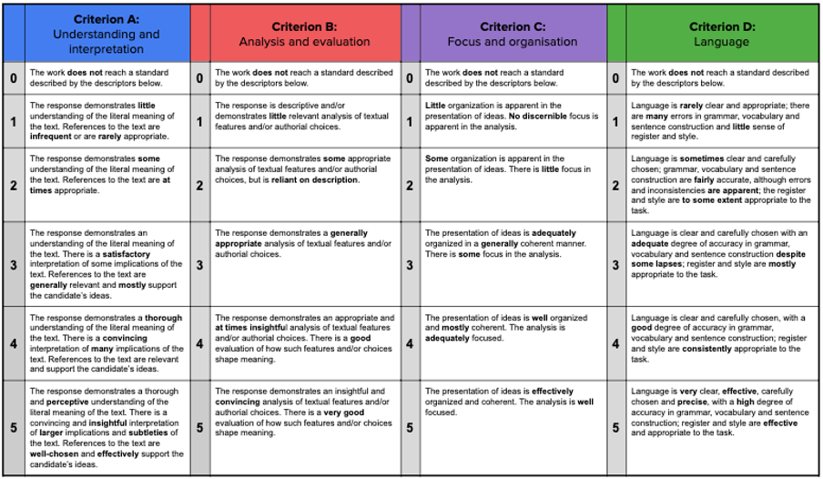
ASSESSMENT CRITERIA

Slide 5






TIPS AND TRICKS
This is a skills-based exam, so remember to practice analysing a range of texts often. Annotate sample language texts, then write an essay plan (thesis + outline).
Time management is tricky, especially at HL. Work up to the point where you can comfortably complete an analytical essay in the time provided.
KNOWING A RANGE OF TEXT TYPES
Texts are written for a variety of different purposes, using different forms and standards of composition. The paper 1 examination assesses your language literacy in this area and so the first step is to know a range of text types.

Slide 6


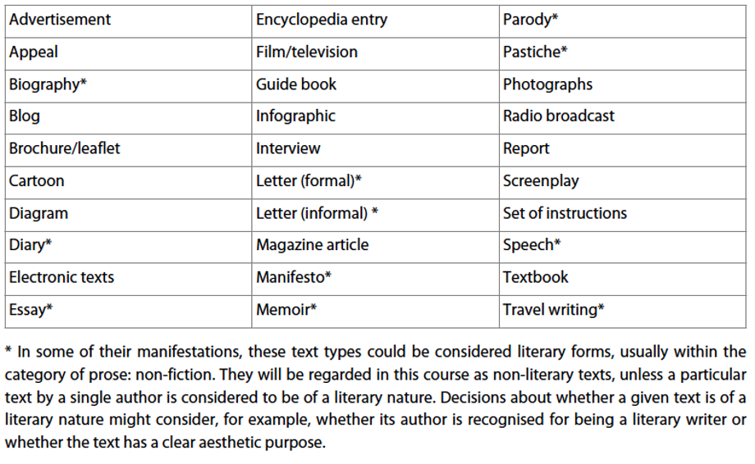



TEXT TYPES

Slide 7





PURPOSE OF TEXT
●entertain – to make the reader enjoy reading
●persuade – to change a reader’s opinion
●advise – to help people decide what to do
●analyse – to break down something to help people to understand it better
●argue – to make the case for something
●describe – to give details about a person, place, event or thing
●explain – to make clear why or how something works
●inform – to tell a reader about something
●instruct – to tell a reader how to do something

Slide 8




IDENTIFYING AUDIENCE, CONTEXT AND PURPOSE(S)
Context:
-When and where was the text produced?
-How does the context of composition influence its content and form?
-Who was the author?
-How does the author’s situation and worldview influence the text?
Audience:
Who is the text aimed at and how can you tell?
(Consider age groups, genders, ethnicities, interest-groups, professions, sub-cultures etc.)

Slide 9



 | Criterion A:Understanding and interpretation
2 | The response demonstrates some understanding of the literal meaning of the text. References to the text are at times appropriate.
3 | The response demonstrates an understanding of the literal meaning of the text. There is a satisfactory interpretation of some implications of the text. References to the text are generally relevant and mostly support the candidate’s ideas.
4 | The response demonstrates a thorough understanding of the literal meaning of the text. There is a convincing interpretation of many implications of the text. References to the text are relevant and support the candidate’s ideas.
5 | The response demonstrates a thorough and perceptive understanding of the literal meaning of the text. There is a convincing and insightful interpretation of larger implications and subtleties of the text. References to the text are well-chosen and effectively support the candidate’s ideas.
THINKING ABOUT IMPLICATIONS
Now look carefully at the highlighted portions of the assessment criteria. It is not enough to just focus on the literal meaning of the text. To score a 3 or above you must interpretimplications and subtleties. What does this mean?
From the IBO guide: Use knowledge and understanding to recognize trends and draw conclusions from given information.
In the context of the paper 1, this could mean:
●commenting on the implicit values or ideas within the text (i.e. things not explicitly stated)
●considering perspectives (i.e. whose voices and perspectives are explored? Whose are missing?)
●noticing subtleelements or impacts of the text that might not be immediately clear to a cursory reader (e.g. subversiveness, irony)

Slide 10
ANALYSING TEXT
“THE BIG 5”
Audience, Purpose, Context
Content, Theme
Tone, Mood, Register
Style
Structure, Layout
The primary goal in this course is to analyse language and literary text. To analyse means to: break down in order to bring out the essential elements or structure. To identify parts and relationships, and interpret information to reach conclusions. (IBO)
The ‘Big 5’ model gives a comprehensive framework, with guiding questions, on how to break down a text. Other similar routines include CAMPS,TAPS etc, but they are all essentially the same. Find what works for you.
When annotating, circle, underline and/or highlight to key parts and techniques used within a text. Label the language technique. Try to identify patterns by connecting these observations.

Slide 11
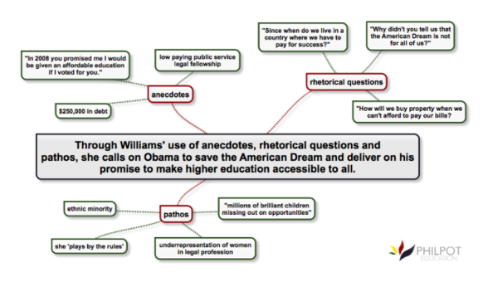


THESIS STATEMENTS
Every essay needs a thesis statement, which is essentially your main argument. Everything that follows will relate back to this sentence.
In a paper 1 essay, thesis statements must:
identify the central purpose and main message of a text
be focused by answering the guiding question (the one provided or your own)
include an outline of your major supporting points.

Slide 12


OUTLINING AN ESSAY
Think of the supporting points, which will become body paragraphs. These points should naturally:
●Thematic / ideas (ideas such as exploration, challenging, equity, stereotypes etc.
●Purpose (‘sub-purposes’ that help achieve the overall purpose, e.g. in order to inform the reader about the nature of volcanoes, the author needs to describe what they look like, explain geological processes etc.)
●Flow-based (every text has a beginning, middle and end - what are these?)
WATCH
MR SATO’S VIDEO ON HOW TO ORGANISE AN ESSAY
HTTPS://WWW.YOUTUBE.COM/WATCH?V=8X5WOCHHTCM

Slide 13



INTRODUCTIONS
Introductions are brief, but extremely important like Mr Sato’s visual analogy - an inverted pyramid.
Introductions can be concise (three sentences) but they must be precise. At the very least, identify the text type, audience, purpose, answer the guiding question and provide an outline of points.
Watch paragraph transition:
https://www.youtube.com/watch?v=6gku-vSf9Rk&list=RDCMUCx7ZSMcv_RPmMlSyHB0-pLQ&index=11

Slide 14





BODY PARAGRAPHS
Sandwiches and burgers are frequent analogies used for body paragraphs. Why? What do you already think you know about this writing skill?
https://www.youtube.com/watch?v=OM-ye5J1tIk
It is very important to balance the points, illustrations and explanations in your essay. Avoid falling into the trap of making too many statements without supporting them with evidence. Alternatively, you can get lost in examples and forget to provide your own critical thinking.
Make with a specific illustration (reference to the text - “For example…”). You should then follow each piece of evidence with analytical discussion (“This shows…”)

Slide 15





CONCLUSIONS
Conclusion for the paper 1 will probably be brief and formulaic. For example, you may simply restate your thesis and main body points in a different way, which is fine for the purposes of this assessment.
Watch: https://www.youtube.com/watch?v=4NaQf3P7pn8

Slide 16




SOURCES:
IBDP Language A: Language and Literature Guide for first teaching in 2019)

